Slide 1
Using all 20 boxes, how many different rectangles can be made from:
4
5

Slide 2
Height | Width
4 | 5
A
B
C
D
E
F
G

Slide 3
Volume of a Cylinder
Sarah Kelleher

Slide 4
Goals
Students will discover the relationship between the dimensions of a rectangle and the volume of its cylinder
Objectives
Given 20 boxes, students will create cylinders and find their volumes with 100% accuracy
Materials
Paper
Scissors
Tape
Plate
M&M’s

Slide 5
Given that we constructed these cylinders out of the exact same materials, do you think they will all hold the same number of M&M’s?

Slide 6
Predict…
Which cylinder do you think has the GREATEST volume? Why?
Which cylinder do you think has the LEAST volume? Why?

Slide 7
Procedure
Pick any two cylinders and stand them up on your plate, one inside the other
Completely fill the inner cylinder with M&M’s
Now, lift the inner cylinder and let the M&M’s fill the outer cylinder
If all the M&M’s do NOT fit in the outer cylinder (it over-flows), then its volume is less than the inner cylinder
If all the M&M’s do fit in the outer cylinder and there is still room for more, then its volume is greater than the inner cylinder
If all the M&M’s fit exactly in to the outer cylinder with no extra space, then the two cylinders have the same volume

Slide 8
Do you see any connection between the sizes of the cylinders and the amounts they hold?

Slide 9
Calculations
Now, we want to use mathematical equations to confirm our results!
$Volume= πr^{2}h$, where…
r = radius of the base
h = height of the cylinder
We can see the height of each cylinder by looking at the height of the rectangle we used to construct it
How can we solve for the radius??

Slide 10
Calculations (continued)
To solve for the radius of the base of the cylinder, we must look at its circumference
The circumference of the base is equal to the width of the rectangle!
$Circumference=2πr$, where…
r = radius of the base of the cylinder

Slide 11


Looking at our 20 x 1 cylinder, where 20 is the height of the rectangle and 1 is the width…
$Circumference=2πr$
$1=2πr$
$\frac{1}{2π}=r$
$0.16 ≈r$
$Volume= πr^{2}h$
$V= π{\left(0.16\right)}^{2}\left(20\right)$
$V=1.61 units$
Look at the rest of the cylinders and try to calculate their volumes! Fill in the table on your worksheet.

Slide 12
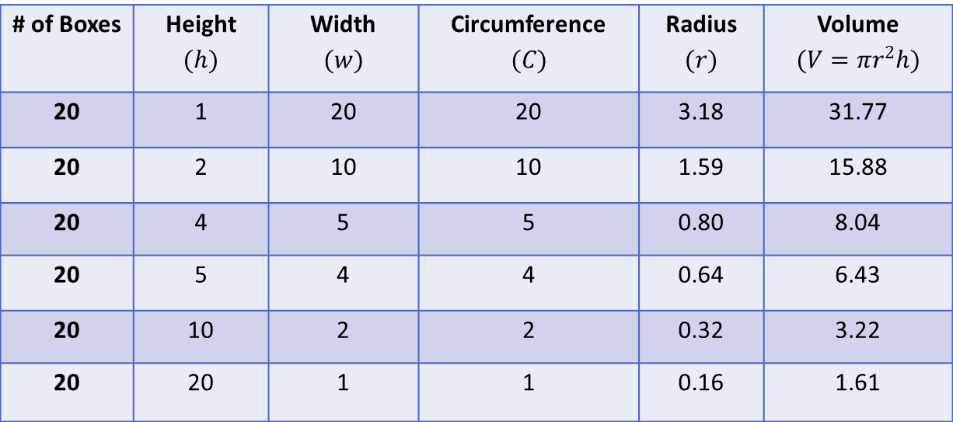
Were we correct?!
# of Boxes | Height $$(h)$$ | Width $$(w)$$ | Circumference $$(C)$$ | Radius $$(r)$$ | Volume $$(V=πr^{2}h)$$
20 | 1 | 20 | 20 | 3.18 | 31.77
20 | 2 | 10 | 10 | 1.59 | 15.88
20 | 4 | 5 | 5 | 0.80 | 8.04
20 | 5 | 4 | 4 | 0.64 | 6.43
20 | 10 | 2 | 2 | 0.32 | 3.22
20 | 20 | 1 | 1 | 0.16 | 1.61

